Slide 1

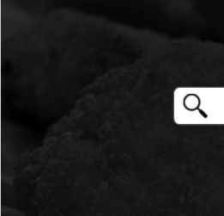

NugSearch
Deliverable 3 - Team McNuggets

Slide 2

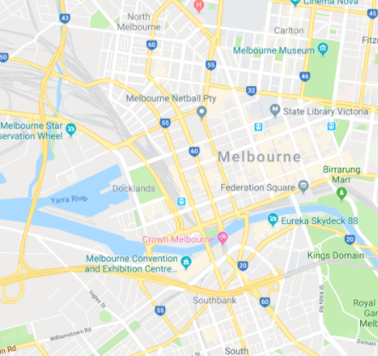

Team McNuggets
BUSINESS VALUE
THE EFFECTS
Only 15% of Australian workers currently have the option of working from home.
Half of UK businesses were caught off guard by the lockdown and had to invest in additional hardware for remote work
30% of Austrian adults reported lower mental well-being during lockdown
Causes cancellation of travel and holiday plans, as well as people travellers being stuck overseas
OUR SOLUTION
Our web-app will better prepare users for potential lockdowns through alerts on when we predict a lockdown is about to occur.
This would allow businesses to carry out the proper procedures of transitioning to remote work if necessary - reducing the effects of lockdown on productivity and profits, as well as allowing users to better plan travel plans.
Our web-app will also allow for users to search for reports about diseases, keeping users updated and informed.
THE ISSUE
With the current COVID-19 pandemic, it has become clear that putting a location (city, state, country) on lockdown is necessary to contain the spread of a virus.

Slide 3
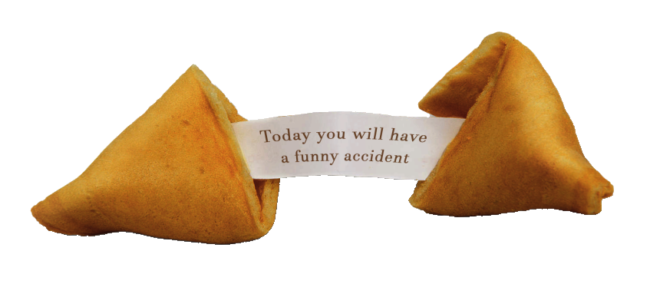
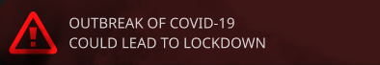
Team McNuggets
REQUIREMENTS
REPORT SEARCHING
VISUALISED REPORTS
Filter searches by location, date, and keywords
Returns reports that include disease name, symptoms, information, and more
Reports are enhanced with extra visuals
Maps displaying location of disease
Graphs describing disease/s occurrences
PREDICTIONS
ALERTS
Creating predictions based on past case numbers which caused lockdowns
States number of cases which caused last lockdown, and compares to current number of cases
Creating alert pages based on predictions
Notifying users of alerts through homepage/other pages
Notes:
Building upon what Luke has said, the requirements and functionalities of our web application aim to solve the problems imposed by disease lockdowns. For our first requirement, with report searching, users may be able to search for reports with proper filtering. For example, a user may search for disease occurrences in their area from the past week. This would help inform users of any diseases in their area, where they could look out for certain symptoms of a new virus, or look out for outbreaks that may occur. For our next requirement, we aim to visually represent these reports with maps and graphs, allowing for a more user-friendly website with detailed representation. We also have a predictions requirement, where our application will predict lockdowns occurring in an area based on past lockdowns. This would lead into our alerts requirement where we would create alert pages based on these predictions. Our alerts will notify users that a lockdown may occur, displaying the number of cases that caused the last lockdown and the number of cases that trigger our lockdown prediction. With these alerts, we hope to better prepare users for potential lockdowns, for example, people travelling overseas may be alerted about a potential lockdown, allowing them react accordingly in a timely manner, whether they need to extend their trip or book early flights back.

Slide 4



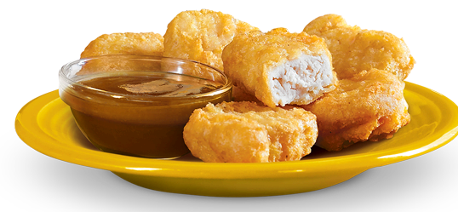



Team McNuggets
TECHNICAL ARCHITECTURE
Client
CLIENT-SIDE
INTERNAL SERVER
EXTERNAL APIs
Notes:
Our Frontend is a React Native Webapp. This is what a client will interact with from their computer - and was chosen due to it’s fast development speed. This web-app then checks for real-time updates from our Python Flask Server operating in the backend to collect data and server responses. Flask is a light-weight with low-overhead python server library, allowing for fast development and quick response times.
The responses from our internal backend are built using a collection of data-points using a variety of APIs, Including:
(Our API) A custom designed and built API that can collect and generate reports from a variety of sources on Pro-Med-Mail
The Sourdough API, that collects information from the World Health Organization and serves it in a computer-friendly manner.
The Google Maps API - a general all rounder api that can help collect and display information, and
The Google Geodecoding API - to allow us to generate information that is specific to our user no matter where they are in the world.
The system has been designed in this manner to allow for ease of use for a user and a quick design process, following an agile development mentality.

Slide 5
Team McNuggets
DEMO
Please stay for a short technical preview of NugSearch

